Slide 1
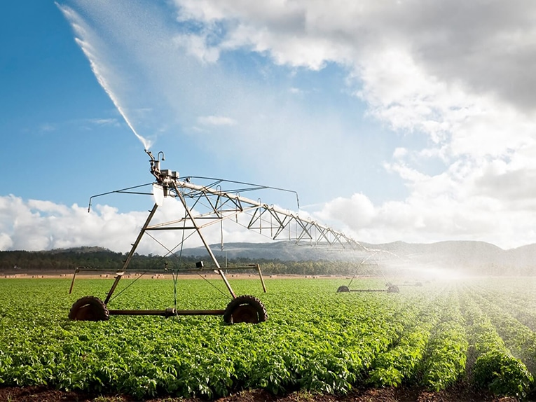
PLANT WATER MONITORING SYSTEM
PRESENTED BY:
21R21A0549 - SANDHYA
21R21A0543 - REENA REDDY
21R21A0550 - PRAGATHI REDDY
21R21A0554 - MUBEEN
22R25A0505 - PRIYANKA

Slide 2
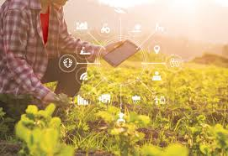
INTRODUCTION
Plant plays a vital role in maintaining the ecological cycle and forms the foundation of a food chain pyramid and thus to maintain the plant’s proper growth and health adequate monitoring is required.
This system would be ideal for the tending of these crops.

Slide 3
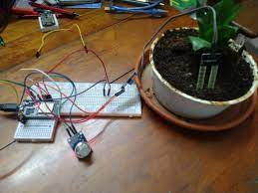
ABSTRACT
The aim of the project is to design, build and implement a simple self-watering system that removes the need for owners of plants to keep a watch on their plants and tend to their needs.
This system will automatically water the plants when needed as to keep them healthy. The goal of this project is to reduce the wasting of water and to implement a system that remove the need for any user input from watering your plants and vegetables.

Slide 4
LITERATURE SURVEY & INFERENCE
S.no | TItle | Author name | Accuracy | Advantages | Disadvantages
1 | Smart Agriculture thatmeasures Moisture level. | Asadi Venkata Mutyalamma | 90% | 1.Livestock monitoring. Monitoring climate conditions Crop monitori ]ng, Farm management systems. | 1. As this project runs with the Internet connection, there is no availability of proper internet connections in the villages.
2 | IoT Smart Plant Monitoring, Watering System | Don Ranul | 85% | 1. Disease control techniques daily to prevent plant illnesses. | 1. Using of IOT in rural area became difficult and not correctly predicting the crop health.
3 | Smart farming using IOT | Mohammed Rashiq | 84% | 1. Users can manually water the plants by checking the soil moisture level at any time | Challenges in network ,not predicting soil PH level.
3 | Smart farming uding IOT | Mohammed Rashiq | 84% | 1. Users can manually water the plants by checking the soil moisture level at any time | Not predicting water level.
4 | I0T BASED SMART PLANT MONITORING SYSTEM | Akshay Bankar | 80% | 1.The wastage of water and the consumption of power by motor can be reduced | This system had incorporated remote monitoring .
5 | Plant Monitoring System | Gaurav Patil | 86% | 1.improves food security and improves productivity of agriculture | Overwatering causes the damage to crops and as well as waste of water, it is not detecting.

Slide 5
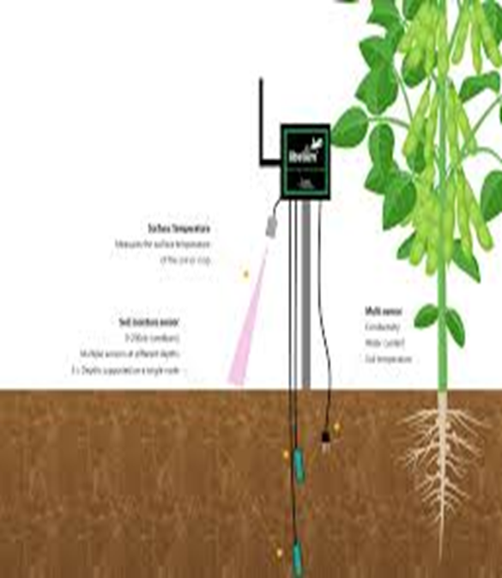
DOMAIN : IOT BASED
SOFTWARE REQUIREMENTS
C language
Arduino IDE
HARDWARE REQUIREMENTS
Arduino UNO
Soil moisture sensor
Servo motor
DC mini water pump
Jumper wire
Breadboard
Single channel relay module
12 volt DC adaptor

Slide 6
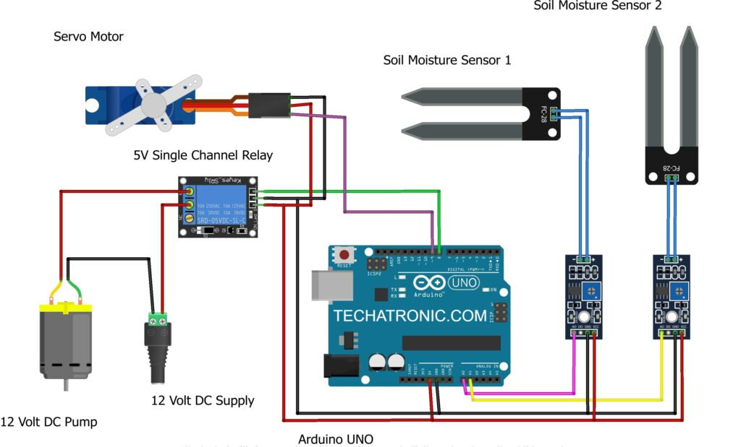
circuit DIAGRAM

Slide 7
working
The first moisture sensor will be located in the first soil sample.
This soil sample will contain very small seedlings that have not taken hold yet. These young seedlings will have little to no effect on the soil as they will not require much water to grow.
The less water required from the seedlings the slow the soil should dry out.
This in turn means that this soil sample should be watered less often.

Slide 8
FUNCTIONAL and non-functional REQUIREMENTS
FUNCTIONAL REQUIREMENTS
NON-FUNCTIONAL REQUIREMENTS
• Availability : system is accessible to a user given point in time.
• Reliability : specifies how likely system would run without fail.
• Maintainability : time required for a solution to be fixed.
• Ease of use
Portability : most of elements of project can quickly oved around from one place to another.
Moisture sensor data collection
Solenoid valves opening

Slide 9
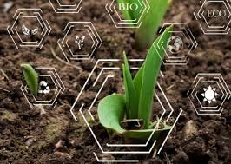
AdvantaGES
Crop Monitoring
Watering plant becomes easy
Water level monitoring
helps to start a better growth of a plant.

Slide 10
CONCLUSION
The reason behind the creation of the smart irrigation system is to address the issue of over watering plants and to remove the possibility of forgetting about watering your plants entirely. The system removes the need to water your plants by hand.

Slide 11
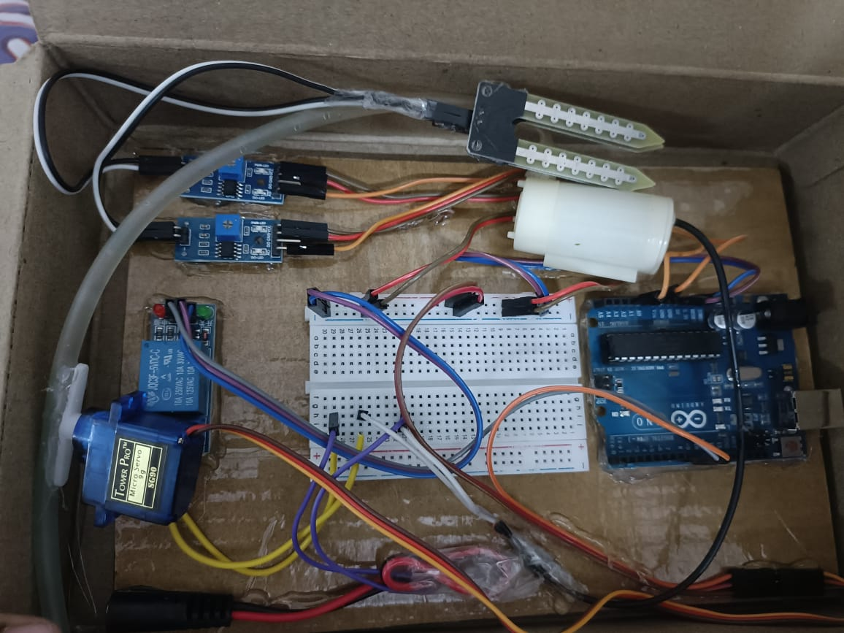
PROJECT PROTOTYPE

Slide 12
Thank You

